Slide 1














WEB DESIGNING
Presented by NO IDEA
Group Member
Chong Meng Wei (SCSJ2300715)
Chen Owen Wei (SCSJ2300675)
Ryan Gridron Wong (SCSJ2300654)

Slide 2

INTRODUCTION
This web development aims to create a user-friendly web-based food delivery platform focused on cafes, allowing users to easily order food, track their deliveries, and give feedback.
It emphasizes accessibility, usability, convenience, and reliability.
developed using HTML, CSS, and JavaScript.

Slide 3
DEVELOPMENT
This delivery app has utilised Hypertext Markup language, Cascading Style Sheets and JavaScript. The reason for the chosen program is for the program’s functionality and effectiveness. The programs were able to showcase the desired design for the website.

Slide 4

HTML
HTML is a coding language that is commonly used to create the layout and content of web pages. In Cafe Dash, HTML is used to define how each page on the website is structured, including things like headings, paragraphs, lists, links, and other elements.

Slide 5

CSS
CSS, or Cascading Style Sheets, is a coding language that is used to control the design and layout of HTML elements on a webpage. It allows developers to customize the appearance of a website by specifying details such as colors, fonts, spacing, and layout

Slide 6

JAVASCRIPT
JavaScript is a coding language that is utilized to introduce interactivity and dynamic behavior to websites.
It allows for real-time updates, validation of forms, manipulation of the Document Object Model (DOM), managing events, and communicating asynchronously with the server.

Slide 7
IMPLEMENTATION
01. HOMPAGE
02. MENU LISTING
03. CHECKOUT PROCESS
04. ORDER TRACKING

Slide 8
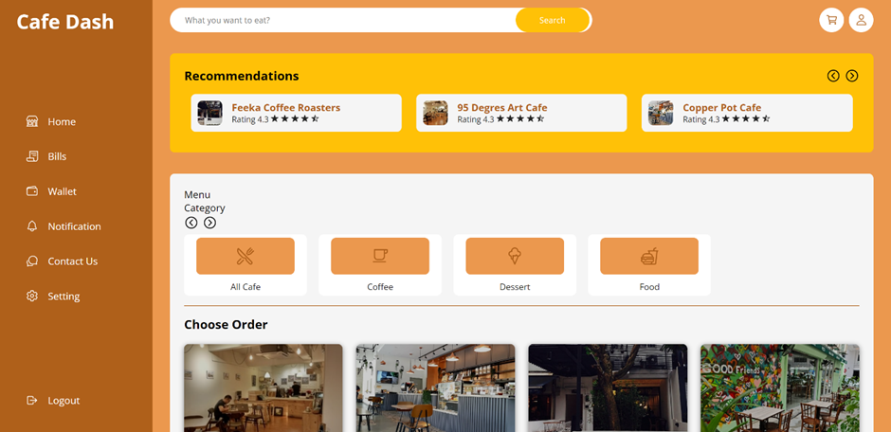
Homepage
The homepage of the website has a banner image that shows the cozy atmosphere of a café. It has a search bar for users to easily find specific cafes or menu items. Featured café listings are shown, along with links to popular sections like restaurant listings, menu display, and order tracking.

Slide 9
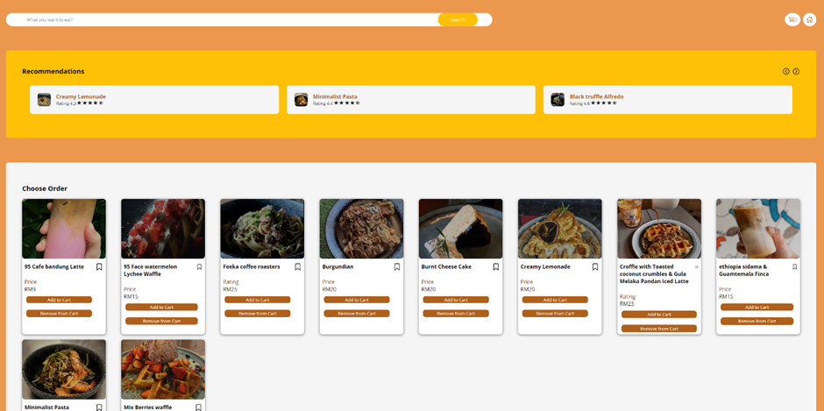
Menu Listing
The menu display page shows the different food and drink options available at a specific café. The items are grouped into categories like drinks, dessert, and dishes. Each item on the menu has a description, price

Slide 10
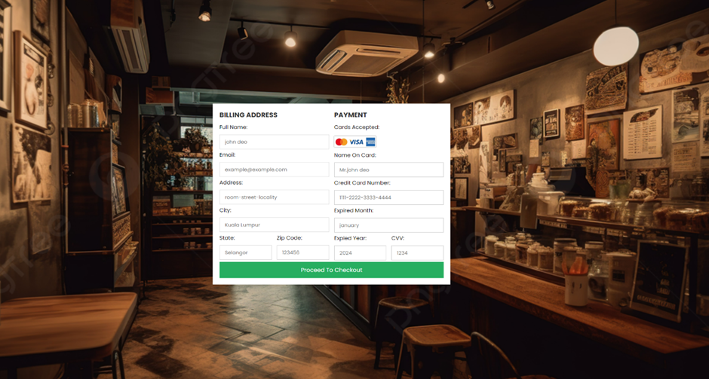
Checkout process
The checkout process is a series of steps that help users select items, customize preferences, enter delivery details, and make payment. Progress indicators and clear instructions make it easier for users to complete their orders smoothly and efficiently

Slide 11
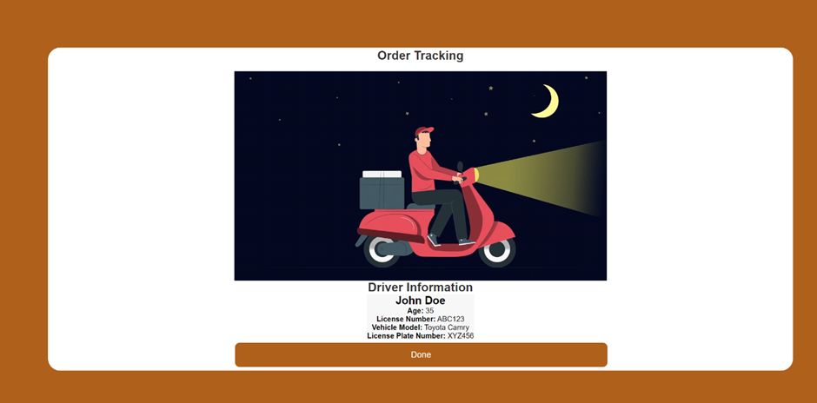
Order Tracking
The order tracking page enables users to keep an eye on the progress of their orders in real-time. Information is continuously updated, starting from order confirmation, through preparation, and all the way to delivery, ensuring that users are kept informed at every step of the process.

Slide 12
Conclusion
In conclusion, Cafe Dash represents a major improvement in the way food can be ordered online and how cafes can be managed. It provides a smooth and pleasant experience for both customers and cafe owners. The platform has been carefully developed through detailed research and creative design, with a focus on making it easy to use, convenient, and reliable

Slide 13
Thank you !

